Slide 1

ProjectIII for UM Fintech BC
Contributor
Eduardo “Edy” Quin

Slide 2
What is ProjectIII about?
ProjectIII is required by the UM BC class. Here, I will attempt to create decentralized applications aimed to perform two things:
A ballot for an annual Board of Directors election; and
A ballot to vote for an annual budget.

Slide 3
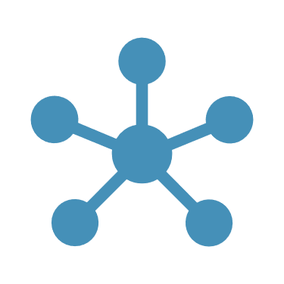
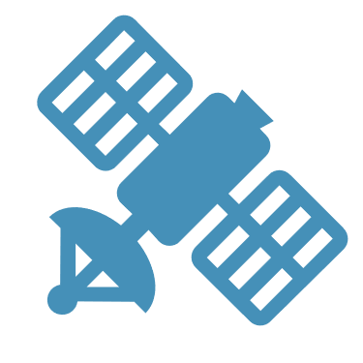
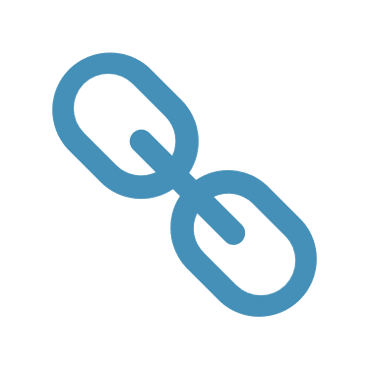
What are Decentralized Applications, or dApps?
dApps are a “software application that has a decentralized operation and uses decentralized storage or a database.” UM BC, Lesson 22.21.

Slide 4
Apps are run on a centralized server and use centralized storage dApps on the other hand, run in a decentralized environment on a blockchain.

Slide 5
dApps are built on decentralized networks like a blockchain.

Slide 6
A “blockchain is a distributed ‘immutable’ database that is not controlled by a single, central authority.” UM Lesson 18.1.

Slide 7
What can we use blockchain for?
Holding your funds, as opposed to your funds being held by a bank
Peer-to-Peer payments
Secure record keeping i.e., title to property, voting, and financial transaction information
To enhance transactional privacy.

Slide 8

Citations
https://www.manning.com/books/building-ethereum-dapps
https://remixide.readthedocs.io/en/latest/running_js_scripts.html#compile-a-contract-and-run-a-script-on-the-fly
Few individuals participate in shareholder voting but that may change (cnbc.com)+ 2020 Proxy Season Review (broadridge.com)
Say Technologies is Joining Robinhood — Under the Hood+ broadridge-proxypulse_2022-season-preview-and-2021-review.pdf
Simplify the annual meeting process for Corporate Issuer | Broadridge
https://www.broadridge.com/white-paper/principles-and-best-practices-for-virtual-annual-shareowner-meetings
Principles and Best Practices for Virtual Annual Shareowner Meetings (broadridge.com)
Say for Investors saytechnologies.com
Say for Public Companies saytechnologies.com
https://www.sec.gov/cgi-bin/browse-edgar?company=&CIK=&type=8-k&owner=include&count=40&action=getcurrent
Solidity by Example — Solidity 0.8.14 documentation soliditylang.org
Solidity by Example — Solidity 0.8.14 documentation (soliditylang.org)

Slide 9
The objective for ProjectIII
The objective of ProjectIII is to utilize blockchain to make corporate processes more efficient and less costly. The corporate processes targeted require the participation of shareholders/constituents spread, often, all over the world. The costs generated by theses processes on an annual basis can be significant. Moreover, as is the case with elections of members of a Board of Directors, the results are often mistrusted and the procedure often opaque at best. Utilizing blockchain to conduct these processes will enhance trust and efficiency.
This project is for educational purposes only.

Slide 10
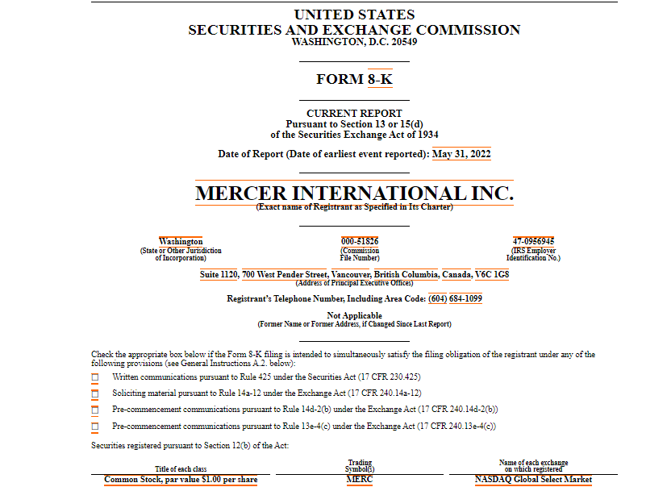
Target Corporate Process 1: Annual Election of Board of Directors
This is an example of the scale of shareholders/constituents of Board of Directors elections, which happen mostly on an annual basis. I used a filed 8-k SEC form from EDGAR.

Slide 11
Target Corporate Process 2: Approval of Annual Budget
This is an example of the scale of shareholders/constituents of Board of Directors elections, which happen mostly on an annual basis. I used a filed 8-k SEC form from EDGAR.

Slide 12
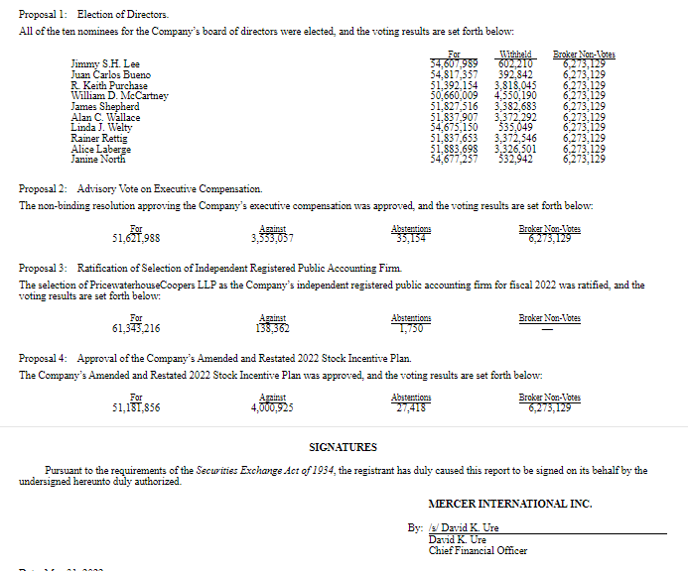
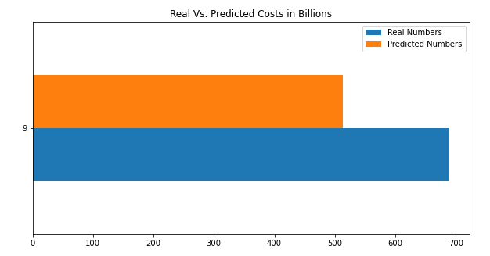
The scale of annual Board of Directors election votes
EDGAR 8-k sample form.

Slide 13
The scale of annual shareholder/constituent votes
EDGAR 8-k sample form.

Slide 14
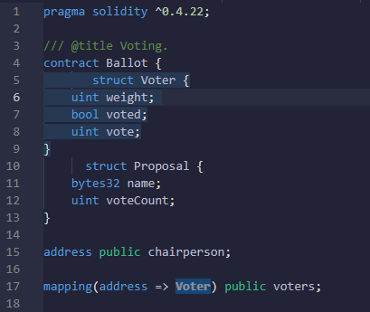
Ballot

Slide 15
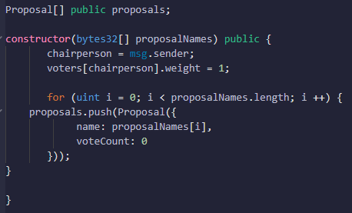
Proposal

Slide 16
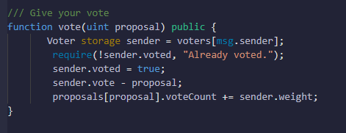
Vote

Slide 17
Vote

Slide 18
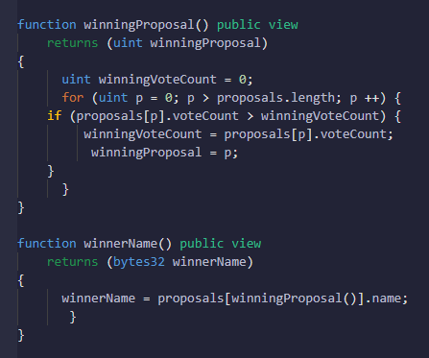
Winning Proposal Name

Slide 19
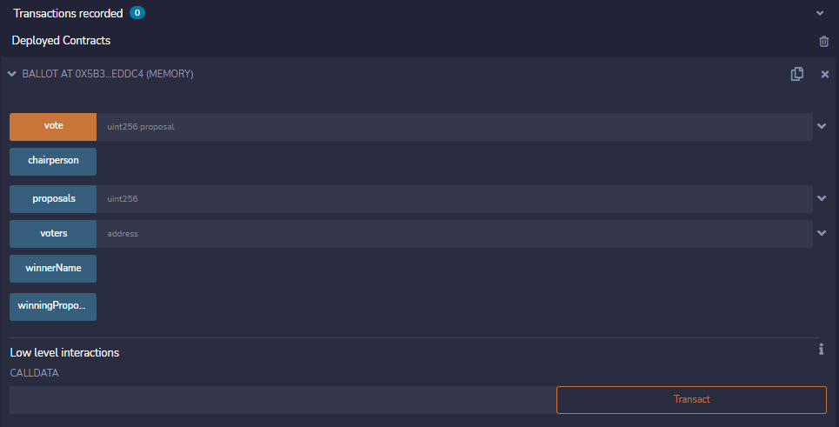
Ballot Smart Contract Deployed in Remix
I know I don’t speak for myself when I say that creating a smart contract on the back end, and launching a dApp on the front end, is something that requires a little bit more than a few weeks of learning and experimenting. So, the best one can do is build upon what has already been created, or attempt to explain it to others as best as one can. The code used for the “Ballot” smart contract is from and based on solidity here Solidity by Example — Solidity 0.8.14 documentation (soliditylang.org). Still, simply copying and pasting the code is not enough, you will get many errors when you try to compile it. So you will have to spend time debugging.

Slide 20
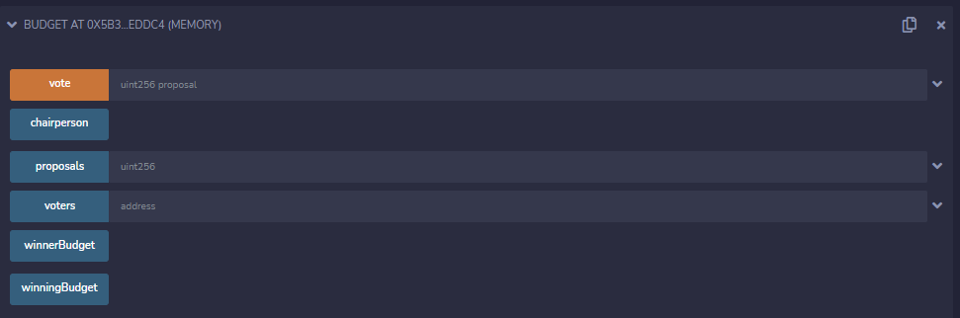
Budget Smart Contract Deployed in Remix
The code used for the “Budget” smart contract is from and based on solidity here Solidity by Example — Solidity 0.8.14 documentation (soliditylang.org). Still, simply copying and pasting the code is not enough, you will get many errors when you try to compile it. So you will have to spend time debugging. Here, I also changed some of

Slide 21
Tools
Solidity
Remix IDE
Ganche

Slide 22
Final Word
Blockchain technology is based upon the trust shared by its constituents, “nodes,”, whether in a cryptocurrency community environment or any other environment. What seems to be the focal point is that by making the procedures and processes of the environment open for anyone to see, and making any changes to the procedures and processes require "consensus" among the community's members, trust is instigated, established, and safe guarded. The nature of decentralized applications on the front end, and “smart contracts” on the back end, is of a self regulated democracy wherein the constituents of it are policing each other, and the language (or code) of the smart contract becomes immutable. The characteristic of immutability of the blockchain, alone, makes it the best alternative for financial transactions and corporate processes and procedures.

